Slide 1




Entity Framework (EF)
ORM and Entity Framework Code First. CRUD Operations
Entity Framework
SoftUni Team
Technical Trainers
Software University
http://softuni.bg

Slide 2



Table of Contents
ORM Frameworks
Entity Framework
Mapping Existing DB with EF Code First
CRUD Operations
Querying Data
Inserting, Updating, Deleting Data

Slide 3
Have a Question?
sli.do #7649

Slide 4
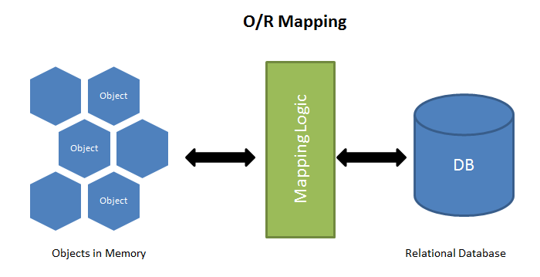
ORM Frameworks – Overview
ORM Frameworks map OOP classes to database tables

Slide 5
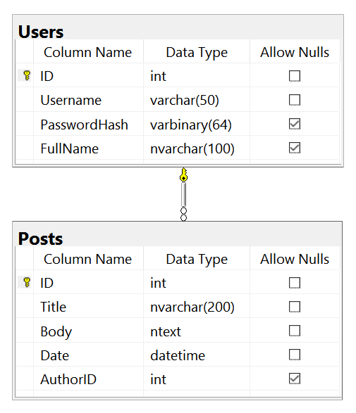
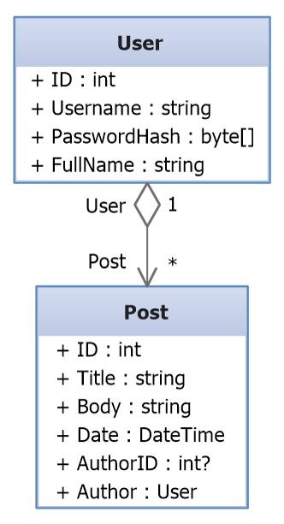




Mapping DB Tables to Classes
Relational DB Schema
ORM
Framework
C# Entity Classes

Slide 6
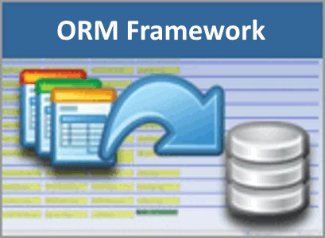
ORM Frameworks – Features
C# / Java / PHP classes are mapped to DB tables
DB relationships are mapped to class associations
ORM provides API for CRUD operations
List objects / query database
Create new object
Update existing object
Delete existing object
ORM provides schema synchronization (DB migrations)
CRUD operations execute
SQL commands in the DB

Slide 7
Entity Framework – Overview
Entity Framework (EF) is modern ORM Framework for C# / .NET
public class BlogDbContext : DbContext
{
public BlogDbContext() : base("name=BlogDbContext") { }
public virtual DbSet<User> Users { get; set; }
public virtual DbSet<Post> Posts { get; set; }
}
class Post { ID, Title, Body, Date, UserID, User }
class Comment { ID, Username, PasswordHash, FullName, Posts }
var db = new BlogDbContext();
foreach (var p in db.Posts)
Console.WriteLine(p.Title);

Slide 8
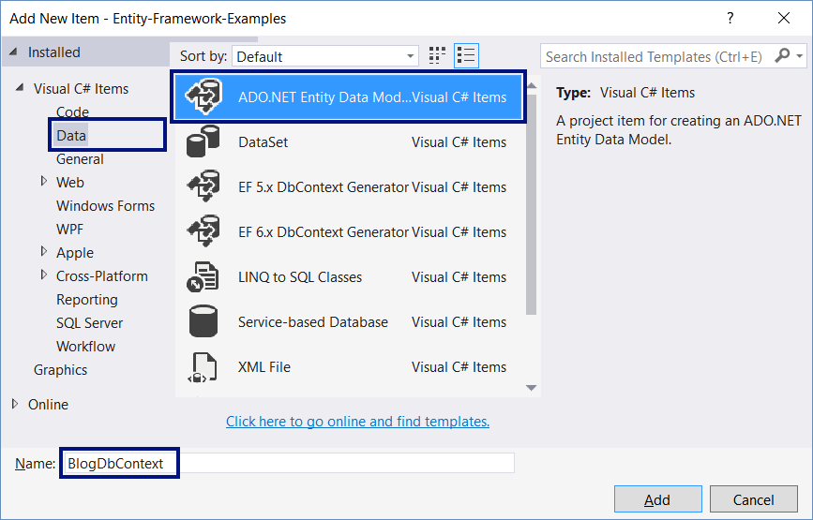
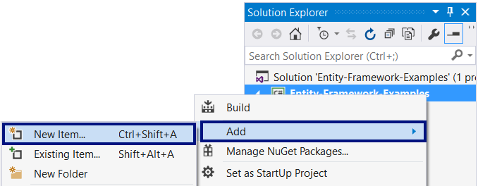
Mapping Existing Database with EF
Add new Entity Data Model

Slide 9
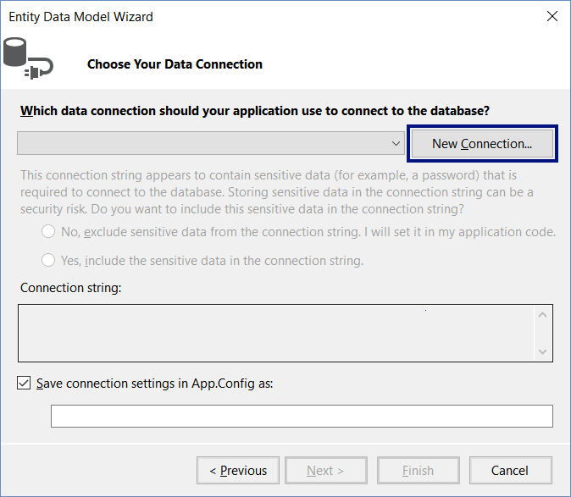
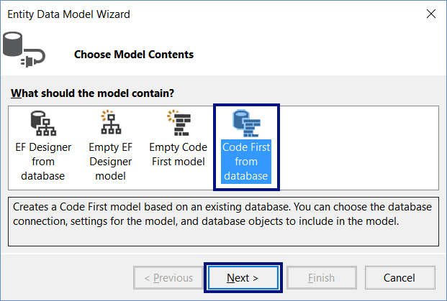
EF Code First Data Model from Database
Generate "Code First" from model database
Define the DB connection

Slide 10
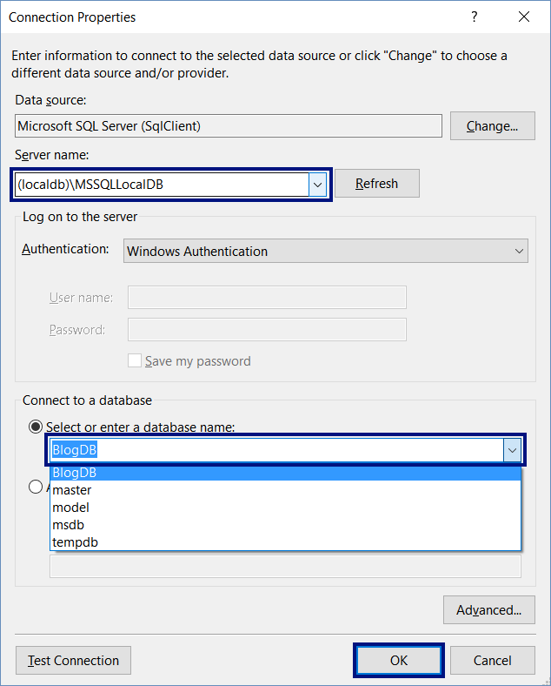
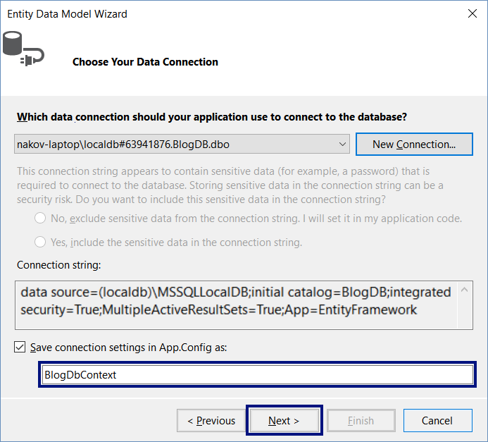
Defining the DB Connection

Slide 11
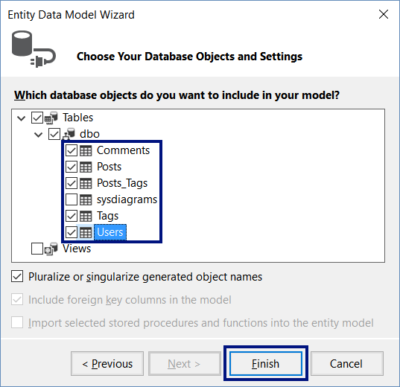
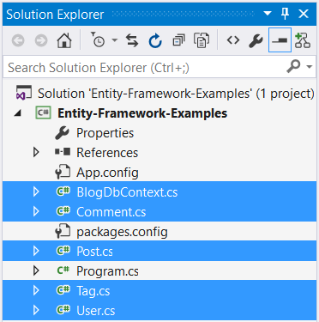
Finish EF Code First Model Generation

Slide 12
Look inside the Generated Code
BlogDbContext.cs
User.cs
public class BlogDbContext
: DbContext
{
public BlogDbContext() : base(
"name=BlogDbContext") { }
…
}
public class User
{
public int ID { get; set; }
public string Username
{ get; set; }
…
}
App.config
Post.cs
<connectionStrings>
<add name="BlogDbContext"
connectionString="data source=(localdb)\MSSQLLocalDB; …
public class Post {
public int ID { get; set; }
…
}

Slide 13
Test the Generated DbContext + Entities
Use the code below to test the generated EF Code First data model (DbContext + Entity Classes)
List all users from the User entity class
static void Main()
{
var db = new BlogDbContext();
foreach (var user in db.Users)
Console.WriteLine(user.Username);
}

Slide 14
Mapping DB Tables with EF Code First
Live Exercise in Class (Lab)

Slide 15
CRUD Operations: Query Data
var db = new BlogDbContext();
// Use LINQ to query the Posts enities
var posts = db.Posts.Select(p => new {
p.ID, p.Title,
Comments = p.Comments.Count(),
Tags = p.Tags.Count() });
Console.WriteLine("SQL query:\n{0}\n", posts);
foreach (var p in posts)
Console.WriteLine($"{p.ID} {p.Title} ({p.Comments} comments, {p.Tags} tags)");

Slide 16
The SQL Query Generated by EF
SELECT
[Project1].[ID] AS [ID],
[Project1].[Title] AS [Title],
[Project1].[C1] AS [C1],
(SELECT
COUNT(1) AS [A1]
FROM [dbo].[Posts_Tags] AS [Extent3]
WHERE [Project1].[ID] = [Extent3].[PostID]) AS [C2]
FROM ( SELECT
[Extent1].[ID] AS [ID],
[Extent1].[Title] AS [Title],
(SELECT
COUNT(1) AS [A1]
FROM [dbo].[Comments] AS [Extent2]
WHERE [Extent1].[ID] = [Extent2].[PostID]) AS [C1]
FROM [dbo].[Posts] AS [Extent1]
) AS [Project1]

Slide 17
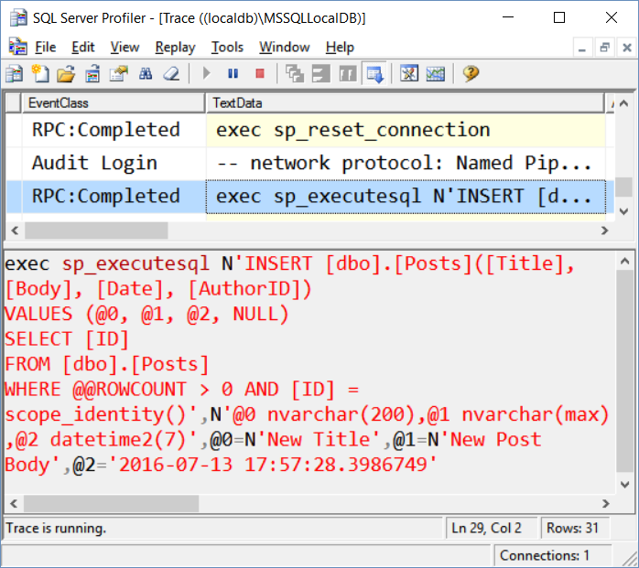
CRUD Operations: Create New Data
var db = new BlogDbContext();
var post = new Post()
{
Title = "New Title",
Body = "New Post Body",
Date = DateTime.Now
};
db.Posts.Add(post);
db.SaveChanges();
Console.WriteLine("Post #{0} created.", post.ID);

Slide 18
CRUD Operations: Cascading Insert
var db = new BlogDbContext();
var post = new Post() {
Title = "New Post Title", Date = DateTime.Now,
Body = "This post have comments and tags",
User = db.Users.First(),
Comments = new Comment[] {
new Comment() { Text = "Comment 1", Date = DateTime.Now },
new Comment() { Text = "Comment 2", Date = DateTime.Now,
User = db.Users.First() } },
Tags = db.Tags.Take(3).ToList()
};
db.Posts.Add(post);
db.SaveChanges();

Slide 19
CRUD Operations: Update Existing Data
var db = new BlogDbContext();
var user = db.Users
.Where(u => u.Username == "maria")
.First();
user.PasswordHash =
Guid.NewGuid().ToByteArray();
db.SaveChanges();
Console.WriteLine(
"User #{0} ({1}) has a new random password.",
user.ID, user.Username);

Slide 20
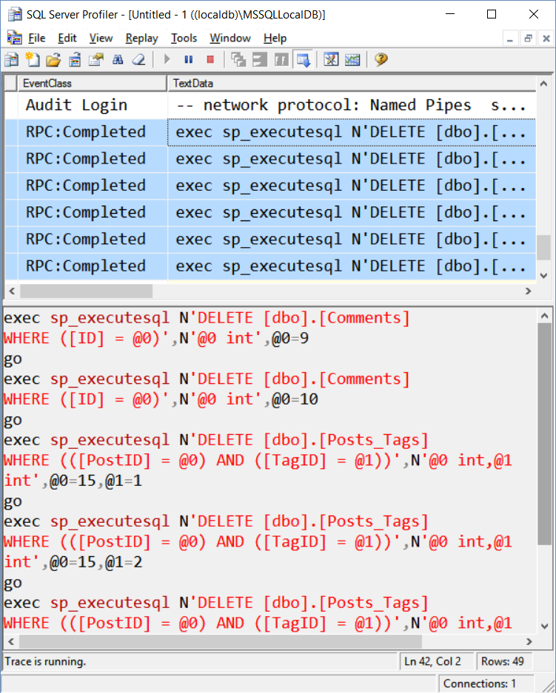
CRUD Operations: Delete Existing Data
var db = new BlogDbContext();
var lastPost = db.Posts
.OrderByDescending(p => p.ID)
.First();
db.Comments.RemoveRange(
lastPost.Comments);
lastPost.Tags.Clear();
db.Posts.Remove(lastPost);
db.SaveChanges();
Console.WriteLine(
$"Deleted post #{lastPost.ID}");

Slide 21
Execute Native SQL
var db = new BlogDbContext();
var startDate = new DateTime(2016, 05, 19);
var endDate = new DateTime(2016, 06, 14);
var posts = db.Database.SqlQuery<PostData>(
@"SELECT ID, Title, Date FROM Posts
WHERE CONVERT(date, Date)
BETWEEN {0} AND {1}
ORDER BY Date",
startDate, endDate);
foreach (var p in posts)
Console.WriteLine(
$"#{p.ID}: {p.Title} ({p.Date})");
class PostData
{
public int ID { get; set; }
public string Title { get; set; }
public DateTime Date { get; set; }
}

Slide 22




CRUD Operations with EF
Live Exercise in Class (Lab)

Slide 23

Summary
ORM Frameworks maps DB tables to classes
Provide API for queries and CRUD operations
Entity Framework is ORM framework for C#
DbContext provides CRUD + LINQ queries
var db = new SomeDbContext();
var entity = db.Entities.First();
db.Entities.Add(new Entity(){ … });
db.Entities.Remove(entity);
db.SaveChanges();

Slide 24








Entity Framework
https://softuni.bg/courses/software-technologies

Slide 25
License
This course (slides, examples, demos, videos, homework, etc.) is licensed under the "Creative Commons Attribution-NonCommercial-ShareAlike 4.0 International" license

Slide 26






Free Trainings @ Software University
Software University Foundation – softuni.org
Software University – High-Quality Education, Profession and Job for Software Developers
softuni.bg
Software University @ Facebook
facebook.com/SoftwareUniversity
Software University @ YouTube
youtube.com/SoftwareUniversity
Software University Forums – forum.softuni.bg

